Slide 1
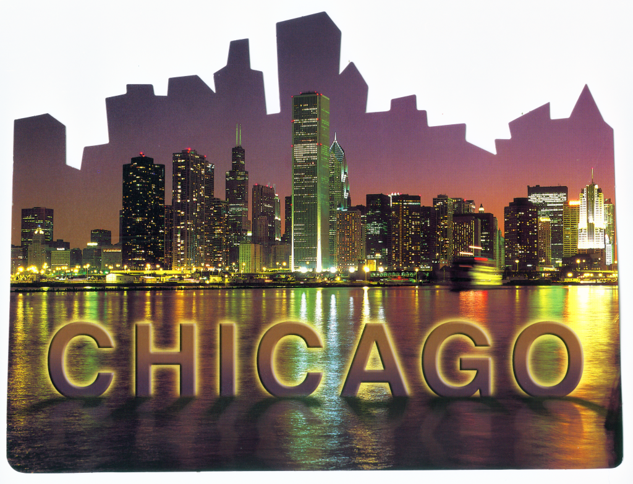
IIMA 2012
October 15-17, 2012

Slide 2
CHICAGO FACTS
The largest city in Illinois
3rd most populous in the US
2.8 million residents
Dozens of
cultural institutions,
historical sites
museums
200 theaters
200 art galleries
7,300 restaurants
100 neighborhoods
26 miles of lakefront
15 miles of bathing beaches
36 annual parades
19 miles of lakefront bicycle paths
552 parks
Home of US President Barack Obama

Slide 3
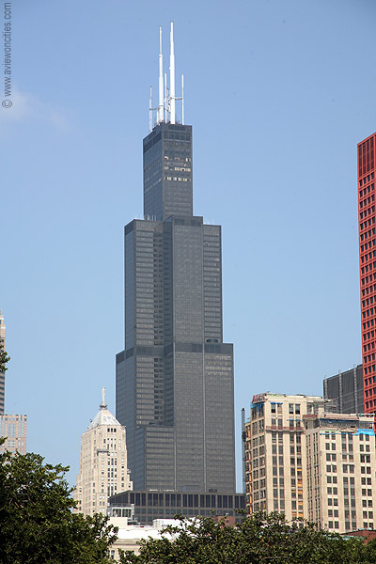
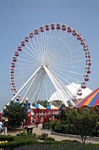
The Willis Tower (formerly Sears Tower)
Navy Pier
Build in 1869 as a recreational and shipping facility, now a popular entertainment center
148 ft (45m) high Ferris Wheel
Children’s museum, Smith museum of Stained Glass Windows
Shakespeare theater complex
Starting point for many boat trips
18 hole miniature golf course, a funhouse maze, a beer garden, a 40ft high wave swinger and an IMAX theater.
World's tallest building (1974), now ranked 7th in the world.
Skydeck Chicago: See breathtaking views of Chicago from the Western Hemisphere's tallest building.
The Ledge, affords visitors a one-of-a-kind experience of Chicago through a glass floor, 1,353 feet above street level!

Slide 4
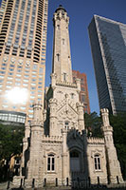
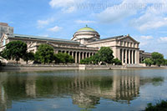
Museum of Science and Industry
Old Water Tower
One of the most popular museums in the United States.
It covers diverse areas like energy, the environment, the human body, space exploration and transportation.
It is located in the South Side, not far from the University of Chicago.
Build in 1869.
The first American Water Landmark.
The Chicago Water Tower and Pumping Station at Michigan and Chicago avenues are among the few buildings to have survived the Great Chicago Fire of 1871.

Slide 5
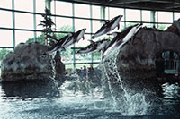
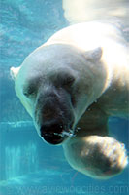
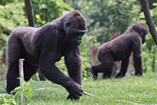
Shedd Aquarium
Lincoln Park Zoo
The largest park in Chicago.
Founded in 1868, the Lincoln Park Zoo is the oldest free public zoo in the country.
Lincoln Park Zoo boasts more than 80 species of mammals, from the ordinary to the exotic.
Popular mammals found at the zoo include polar bears, sun bears, camels, giraffes, lions and rhinoceros.
Located at the Museum Campus, just south of Grant Park.
Houses 20,000 aquatic animals representing 1,500 different species.
Contains several exhibits, the most notable of which are the Caribbean Reef, the Wild Reef and the Oceanarium.
Polar Bear
Gorilla

Slide 6
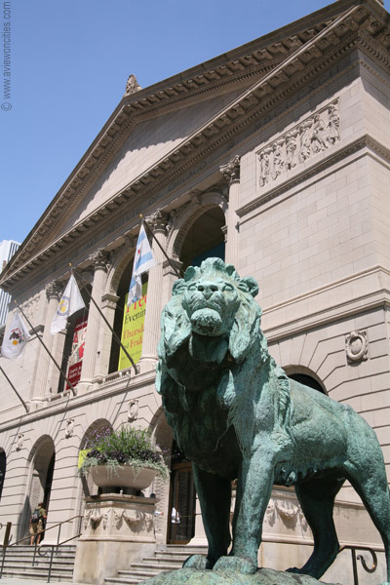
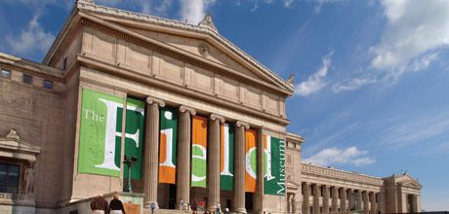
Field Museum
Art Institute of Chicago
One of the finest natural history museums in the U.S.
It gained national acclaim when Steven Spielberg made it the home base for the esteemed archaeologist in his Indiana Jones movies.
Founded in 1879 as both a school and museum
The building that originally housed the Art Institute of Chicago was built atop rubble from the great Chicago fire.
The permanent collection inside the Art Institute of Chicago is so extensive that it'll take you several hours to explore the whole thing.

Slide 7
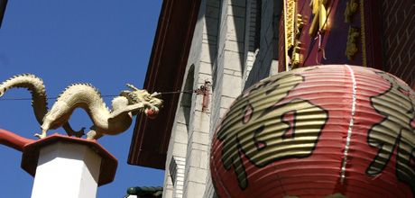
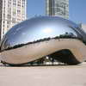
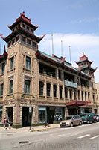
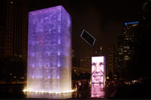
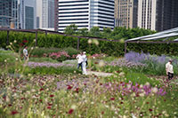
Millennium Park
Chinatown
Chicago's Chinatown isn't just a place for those of Chinese descent to gather. It's a colorful neighborhood for all to enjoy.
The 24.5 acre Millennium Park is a magnificent modern park with state of the art facilities, unique public artwork and beautiful gardens.
The Clould Gate is among the largest sculpture of its kind in the world, it reflects the magnificent Chicago skyline.
Clould Gate
Crown Fountain at night
Lurie Garden

Slide 8
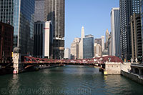
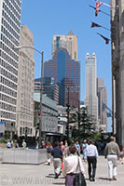
Magnificent Mile
Chicago River
Northern part of Michigan Avenue between the Chicago River and Lake Shore Drive
a grand wide boulevard with exclusive shops, museums, restaurants and ritzy hotels.
Shopper's Paradise. All the big names in shopping are present here, from Disney, Apple and Niketown to Bloomingdales and Saks Fifth Avenue.
The areas around the Magnificent Mile are some of Chicago's wealthiest.
Flowing through downtown Chicago.
Once a corridor of commercial activity, the river has been transformed into a recreational area with sightseeing boats.
Along the banks are pedestrian friendly promenades lined with café's and eateries.

Slide 9
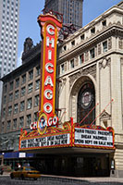
Chicago Chamber of Commerce
Chicago Theatre
Built in 1921 during the Golden Age of entertainment, the Chicago Theatre was the first of its kind
unique architectural touches in this French Baroque-style theater
Dubbed "The Wonder Theatre of the World"
present top-name live entertainment with a little something from everyone, from pop performers to comedians to international dance troupes.
19
“The great Central Market,” though its recent emphasis on global trade and on regional economic planning
The Chicago area is home to regional chambers of commerce
Chicago Southland Chamber of Commerce
Cosmopolitan Chamber of Commerce,
Polish-American Chamber of Commerce.
French-American Chamber of Commerce of Chicago and
the America-Israel Chamber of Commerce

